Slide 1
Year 5 Unit 4
Lesson 4

Slide 2
This house is not big enough.

Slide 3
This sofa ……………………..

Slide 4
This sofa is not big enough.

Slide 5
The girl is …………………….

Slide 6
The girl is not tall enough.

Slide 7
You are not big enough.
Let’s think:
Who is saying it?
Where?
Why?

Slide 8
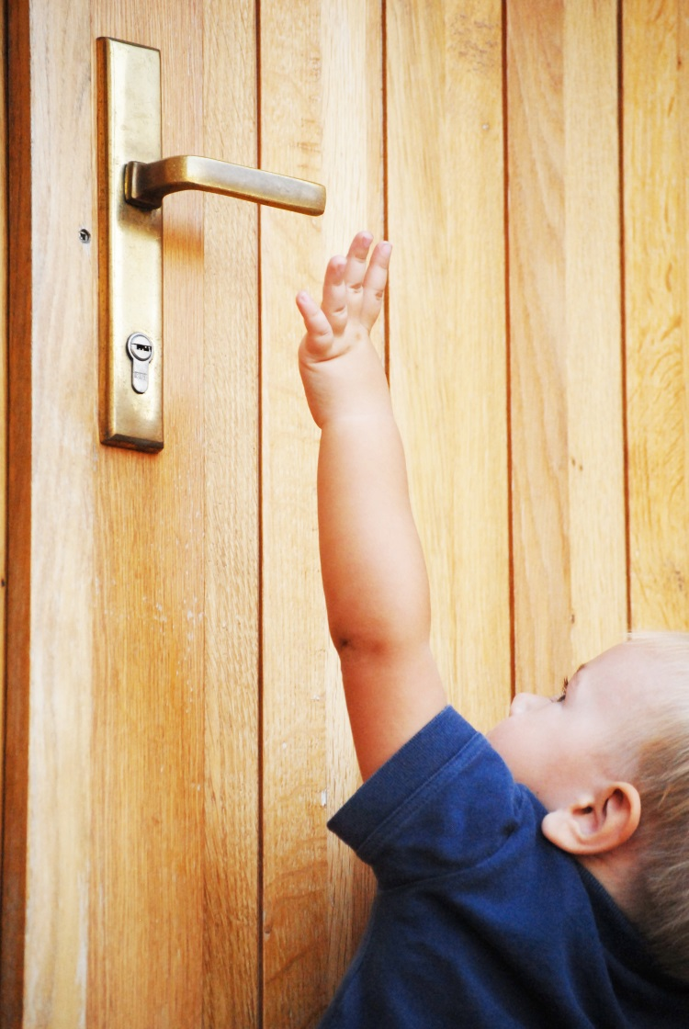
You are not big enough.

Slide 9
You are not fast enough.
Let’s think:
Who is saying it?
Where?
Why?

Slide 10
You are not fast enough.

Slide 11
This is not big enough.
Let’s think:
Who is saying it?
Where?
Why?

Slide 12
This is not big enough.

Slide 13
Presentation designed by the English Curriculum Development team, Cyprus Ministry of Education and Culture

