Slide 1
Unit 3 Year 5
Lesson 1 – Presentation 1

Slide 2
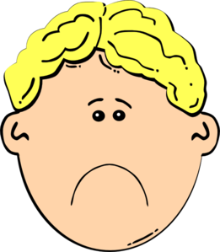
How does he feel?
Why is he sad?

Slide 3
Because …………….

Slide 4
Because he is very hungry!

Slide 5
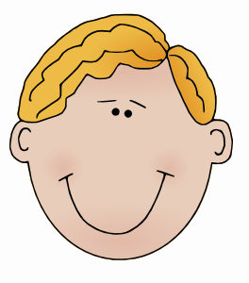
How does he feel now?
Why is he happy now?

Slide 6
Because ………………….

Slide 7
Because he is going to eat spaghetti.

Slide 8
How does she feel?
Why is she angry?

Slide 9
Because ………………….

Slide 10
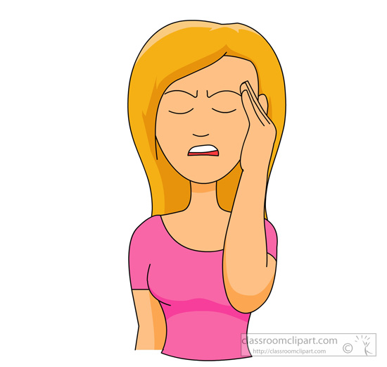
Because she has a headache.

Slide 11
She’s going to ……………..

Slide 12
She’s going to take an aspirin.

Slide 13
Images courtesy of:
http://classroomclipart.com/
http://www.clker.com/
Presentation designed by the English Curriculum Development team, Cyprus Ministry of Education and Culture

