Slide 1
Unit 3
Lesson 2
Presentation 2 - evaluation

Slide 2

The books are on the ……… .
shelves

Slide 3


The cat is ………. the bedside table.
next to

Slide 4
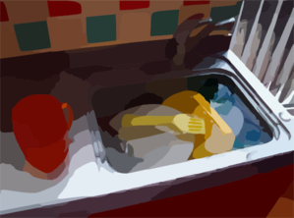
The dishes are in the ……….
sink

Slide 5
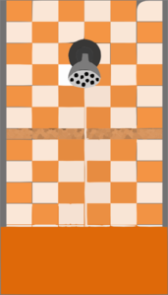

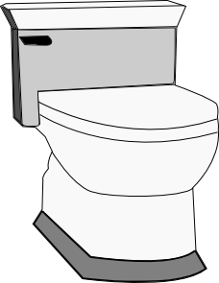
washbasin
The ………. is between the toilet and the ……….. .
shower

Slide 6
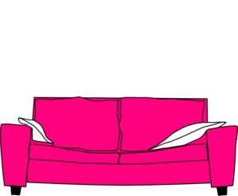

The ball is ……. the sofa.
under

Slide 7


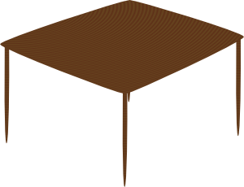
The TV is ……. the chair.
opposite

Slide 8
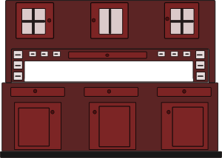
The table is ……. the cupboards.
in front of

Slide 9
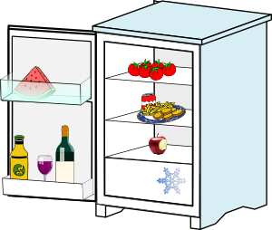
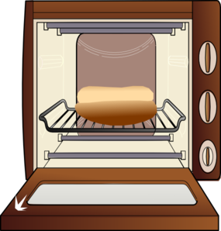
The cooker is ……. the fridge.
next to

Slide 10

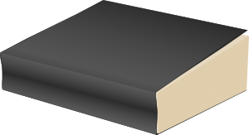
The book is under the …...
rug

Slide 11
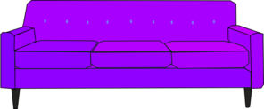
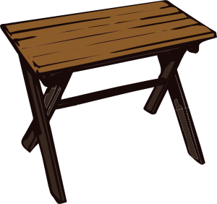
The sofa is ……. the table.
near

Slide 12

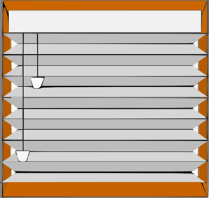
The window is ……………. the door.
far from

Slide 13
Images courtesy of:
http://www.microsoft.com
http://www.clker.com
Presentation designed by the English Curriculum Development team, Cyprus Ministry of Education and Culture

