Slide 1
Unit 3
Lesson 2
Presentation 1

Slide 2

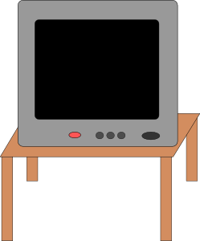

The TV is next to the door.

Slide 3
The sofa is on the rug.

Slide 4

The sofa is next to the TV.

Slide 5
The sofa is opposite the TV.

Slide 6
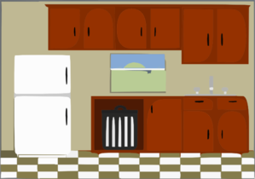
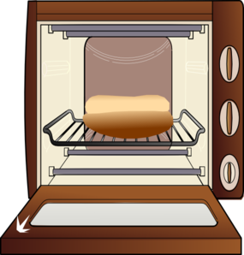
The fridge is opposite the cupboards.

Slide 7
The fridge is near the cupboards.

Slide 8
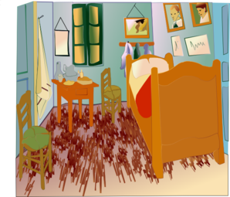
The bed is far from the bedside table.

Slide 9
The bed is near the bedside table.

Slide 10

The dog is under the desk.

Slide 11

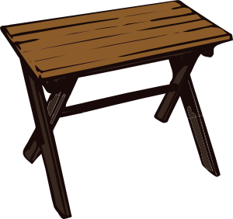
The swimming pool is between the table and the chair.

Slide 12
The swimming pool is near the table and the chair.

Slide 13

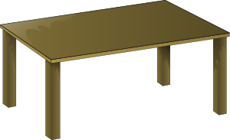
The chair is behind the table.

Slide 14


The shelves are near the computer.

Slide 15
The shelves are far from the computer.

Slide 16
The woman is in front of the washbasin.

Slide 17
The boy is in the bath.

Slide 18
Images courtesy of:
http://www.microsoft.com
http://www.clker.com
Presentation designed by the English Curriculum Development team, Cyprus Ministry of Education and Culture

