Slide 1
Unit 2 Year 6
Presentation 1
Inventions and inventors

Slide 2
Who invented the airplane?

Slide 3
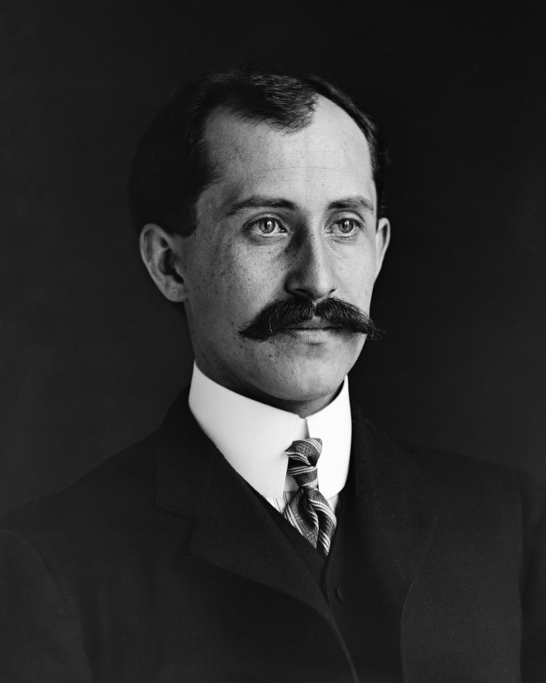
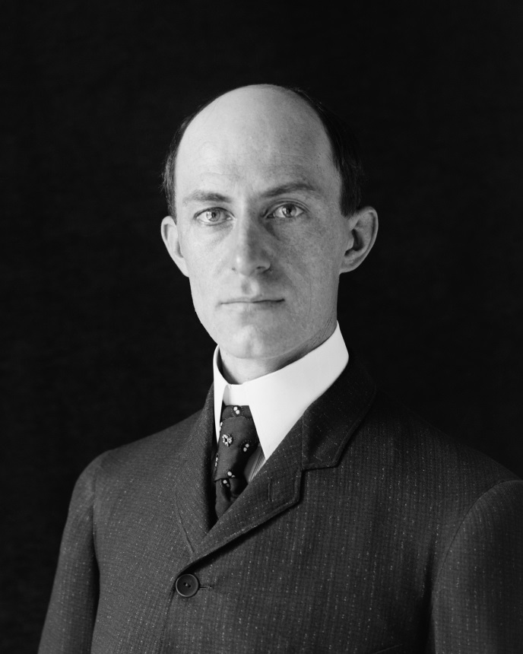
Orville and Wilbur Right invented the airplane.
Notes:
Who invented the ….?

Slide 4
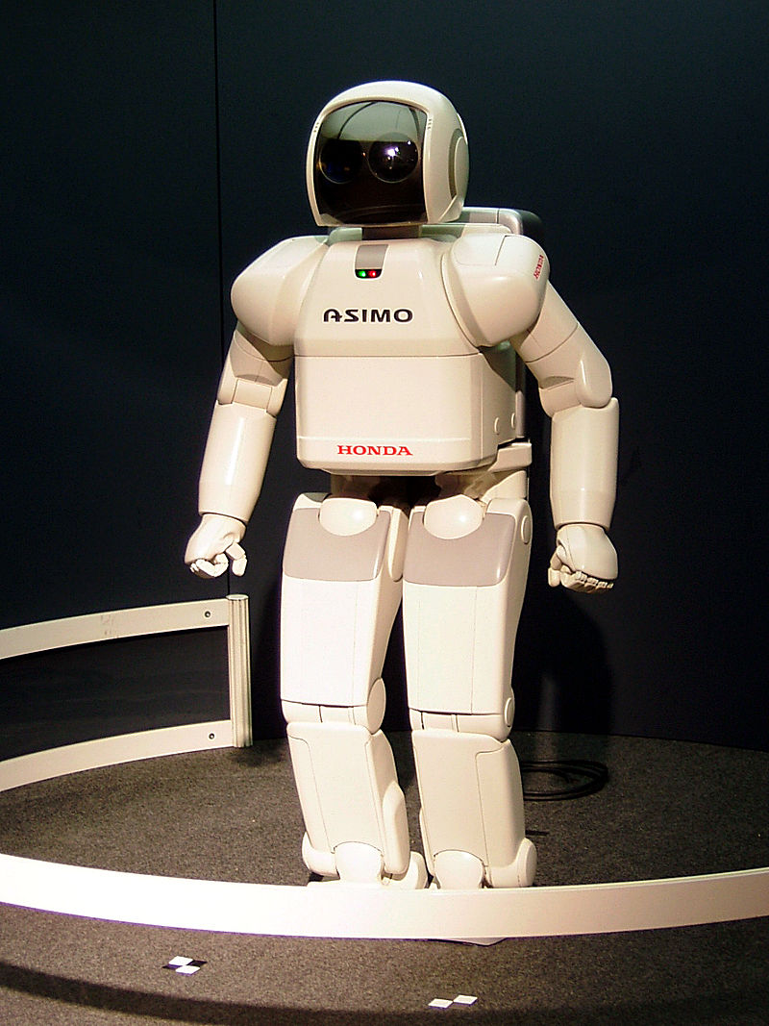
Who invented the robot?

Slide 5
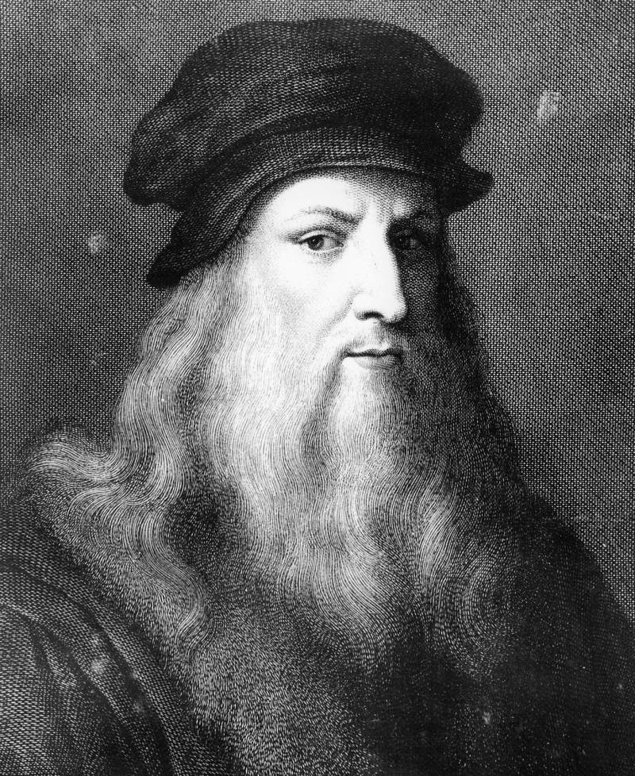
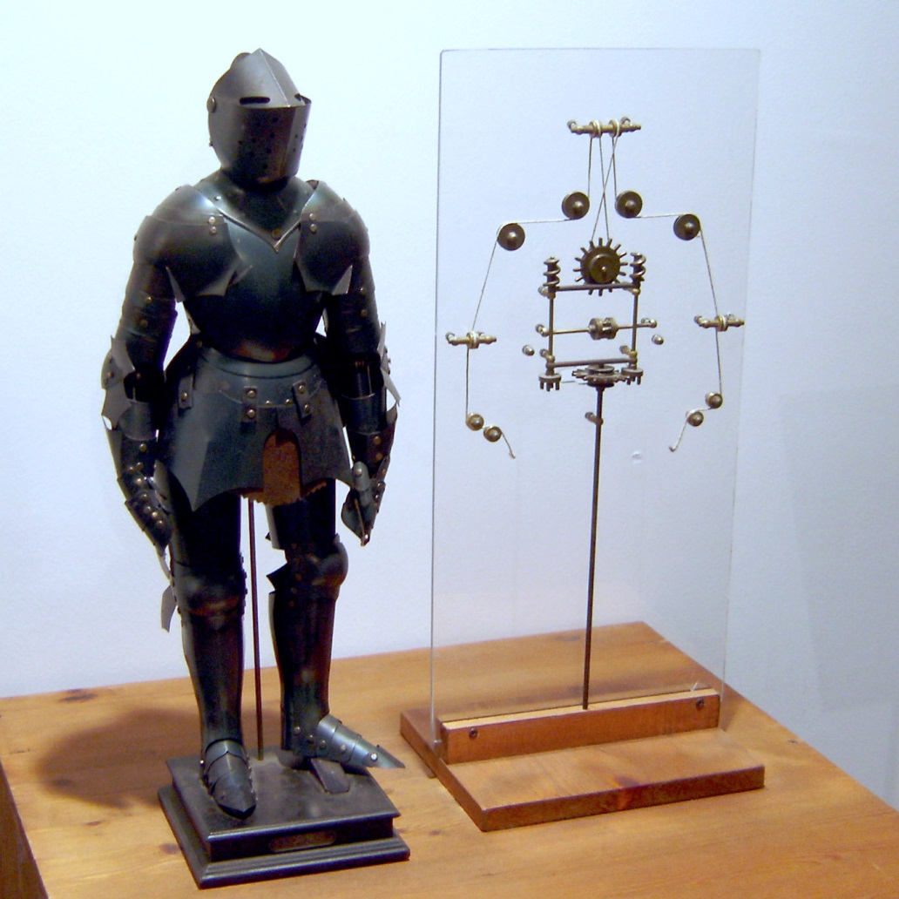
Leonardo Da Vinci invented the robot.

Slide 6
Who invented the telescope?

Slide 7
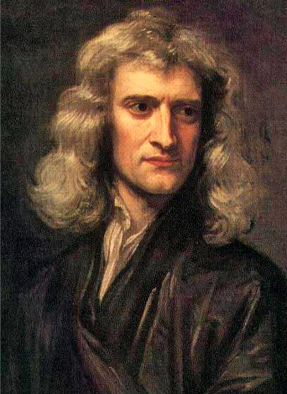
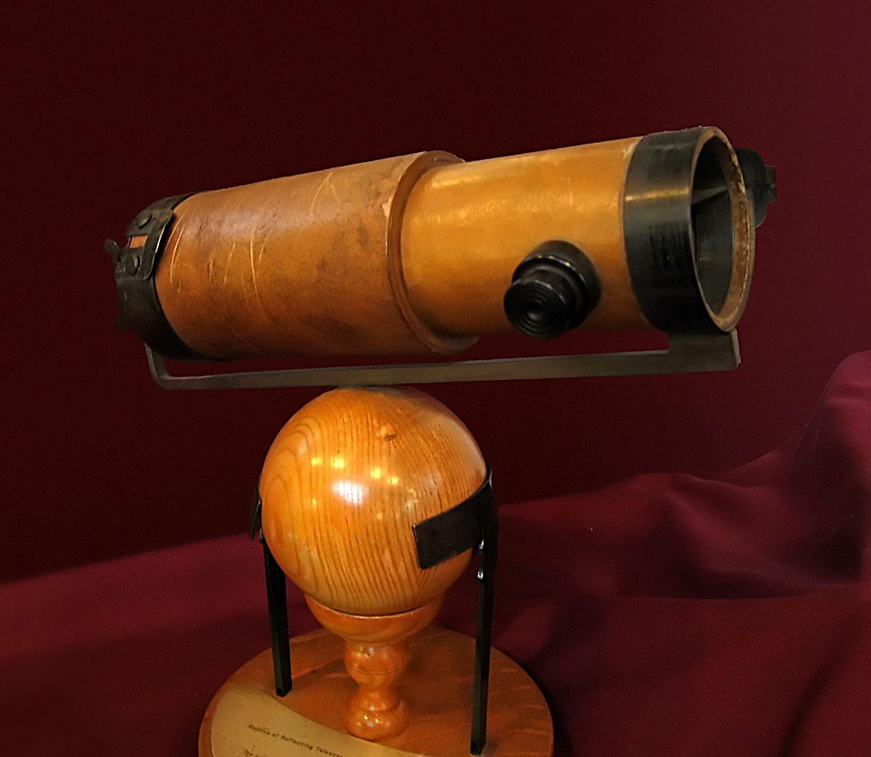
Isaac Newton invented the telescope.

Slide 8
Who invented the telephone?

Slide 9
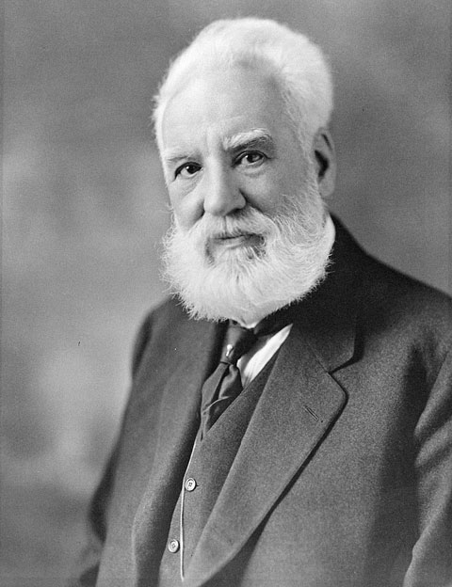
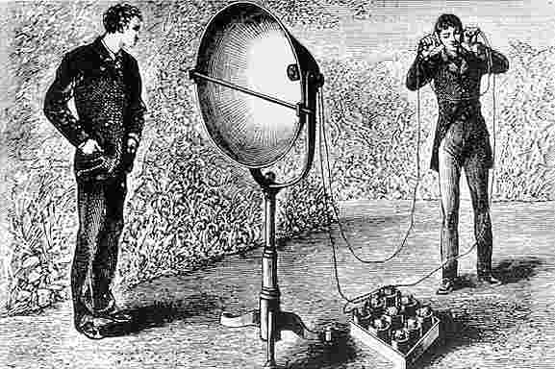
Alexander Graham Bell invented the telephone.

Slide 10
Images courtesy of:
"Orville Wright 1905-crop" by Orville Wright and Wilbur Wright (credited as photographers) [1], [2] - Library of CongressNative nameLibrary of CongressLocationWashington, D.C.Coordinates38° 53′ 19″ N, 77° 00′ 17″ WEstablished1800Websitewww.loc.gov. Licensed under Public Domain via Commons - https://commons.wikimedia.org/wiki/File:Orville_Wright_1905-crop.jpg#/media/File:Orville_Wright_1905-crop.jpg
"Wilbur Wright-crop" by Orville Wright and Wilbur Wright (credited as photographers) [1], [2] - Library of CongressNative nameLibrary of CongressLocationWashington, D.C.Coordinates38° 53′ 19″ N, 77° 00′ 17″ WEstablished1800Websitewww.loc.gov. Licensed under Public Domain via Commons - https://commons.wikimedia.org/wiki/File:Wilbur_Wright-crop.jpg#/media/File:Wilbur_Wright-crop.jpg
"1902 Wright glider turns" by Attributed to Wilbur Wright (1867–1912) and/or Orville Wright (1871–1948). Most likely taken by Orville Wright. - Scan from original on glass plate negative (itself from Library of Congress). Licensed under Public Domain via Commons - https://commons.wikimedia.org/wiki/File:1902_Wright_glider_turns.jpeg#/media/File:1902_Wright_glider_turns.jpeg
"LEONARDO". Licensed under Public Domain via Commons - https://commons.wikimedia.org/wiki/File:LEONARDO.JPG#/media/File:LEONARDO.JPG
"Leonardo-Robot3" by Photo by Erik Möller. Leonardo da Vinci. Mensch - Erfinder - Genie exhibit, Berlin 2005. - Own work. Licensed under Public Domain via Commons - https://commons.wikimedia.org/wiki/File:Leonardo-Robot3.jpg#/media/File:Leonardo-Robot3.jpg
"GodfreyKneller-IsaacNewton-1689" by Sir Godfrey Kneller - http://www.newton.cam.ac.uk/art/portrait.html. Licensed under Public Domain via Commons - https://commons.wikimedia.org/wiki/File:GodfreyKneller-IsaacNewton-1689.jpg#/media/File:GodfreyKneller-IsaacNewton-1689.jpg
"NewtonsTelescopeReplica" by User:Solipsist (Andrew Dunn) - www.andrewdunnphoto.com. Licensed under CC BY-SA 2.0 via Commons - https://commons.wikimedia.org/wiki/File:NewtonsTelescopeReplica.jpg#/media/File:NewtonsTelescopeReplica.jpg
"Alexander Graham Bell" by Moffett Studio - Library and Archives Canada / C-017335. Licensed under Public Domain via Commons - https://commons.wikimedia.org/wiki/File:Alexander_Graham_Bell.jpg#/media/File:Alexander_Graham_Bell.jpg
"Photophony1" by Unknown - http://www.bluehaze.com.au/modlight/ModLightBiblio.htm. Licensed under Public Domain via Commons - https://commons.wikimedia.org/wiki/File:Photophony1.jpg#/media/File:Photophony1.jpg
Robot - "HONDA ASIMO". Licensed under CC BY-SA 3.0 via Commons – https://commons.wikimedia.org/wiki/File:HONDA_ASIMO.jpg#/media/File:HONDA_ASIMO.jpg
"Telescope" by Users Ericd on en.wikipedia. Licensed under CC BY-SA 3.0 via Commons - https://commons.wikimedia.org/wiki/File:Telescope.jpg#/media/File:Telescope.jpg
Presentation designed by the English Curriculum Development team, Cyprus Ministry of Education and Culture

