Slide 1
Unit 3
Lesson 1
Presentation 1

Slide 2
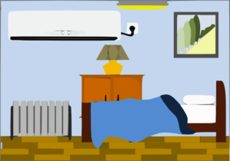


picture
bookcase
bed
lamp
bedside table
rug

Slide 3







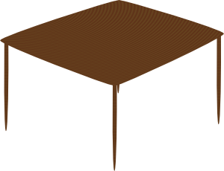

wall
curtains
shelves
sofa
armchair
TV
table

Slide 4


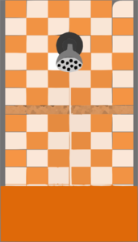
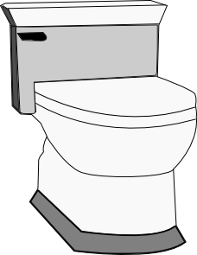
window
shower
toilet
washbasin

Slide 5
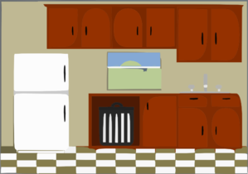


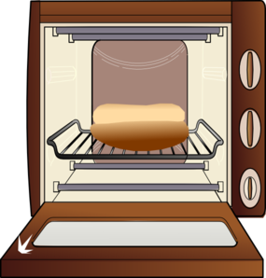


cupboards
fridge
sink
cooker
oven
chair
table

Slide 6
Images courtesy of:
http://www.microsoft.com
http://www.clker.com
Presentation designed by the English Curriculum Development team, Cyprus Ministry of Education and Culture

