Slide 1
Unit 3 Year 6
Lesson 1 – presentation 2

Slide 2
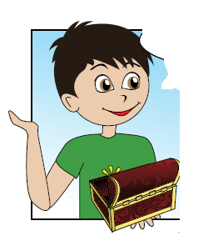
On Monday I’m going to visit ….

Slide 3
Presentation designed by the English Curriculum Development team, Cyprus Ministry of Education and Culture

